Slide 1
Welcome to Arabic Level I by Kurzban

Slide 2

Lesson 9:
Objectives:
Review
Identifying Letter Haa, Mim, lam, and kaf
objects from immediate environment
Expressing Possession.
Practice
Summary
Flash card

Slide 3
The letter Ha _ه_ as in house
Ha changes its shape depending on how and where it is joined, so take extra care.
1) if it is NOT joined to any other letter: ___
2) If it is joined only to the letter after it:___
3) If it is joined only to the letter before it:__
4) If it is joined to letters on both sides:___

Slide 4
Let’s practice Ha: ____ه
Connect the following letters:
ن+ه+ر=

Slide 5
Practice with ha
ه+ي=
ه+ و=

Slide 6
Practicing with ha
“This is “ for {F}
ه+ذ+ه=
“This is” for {M}
ه+ذ+ا=

Slide 7


Ha at the end: Most likely will be used as (his/hers)
ب+ن+ت+ه+ا=
ب+ن+ت+ه=

Slide 8

Lesson 9: Building up your vocabulary
Copy down and translate the following words on your paper several times and remember to proceed from right to left.
________________

Slide 9
The letter “Kaf”. It’s like ha, it changes its shape depending on how it is joined:
If it stands at the beginning or in the middle of a word, it looks like this:
If it stands on its own or is at the end of a word, it looks like this:

Slide 10
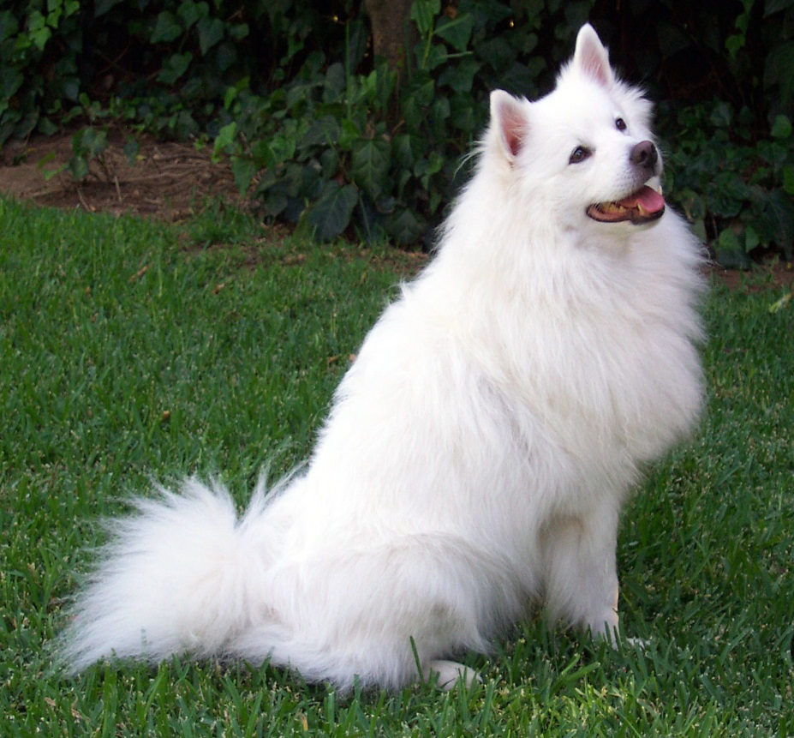
Let’s practice with kaf
ك+ل+ب=

Slide 11

Practicing with Kaf
ك+ع+ك=

Slide 12
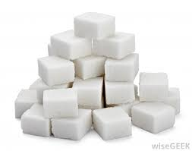
Practicing with Kaf:
س+ك+ك+ر=

Slide 13

Lesson 9: Building up your vocabulary
Copy down and translate the following words on your paper several times and remember to proceed from right to left.
Use “this is” F? M?

Slide 14

Lesson 9: Building up your vocabulary
Copy down and translate the following words on your paper several times and remember to proceed from right to left.
:use “this is” F? M?

Slide 15

Lesson 9: Building up your vocabulary
Copy down and translate the following words on your paper several times and remember to proceed from right to left.
Use “this is” F?M?

Slide 16

Lesson 9: Building up your vocabulary
Copy down and translate the following words on your paper several times and remember to proceed from right to left.
Use this is: F?M?

Slide 17
Lesson 9: Expressing Possession
One way of expressing possession is by using a phrase made up of the adverb_عـندك Literally, “at” and an attached pronoun.
Together they form one word, Thus, in order to say to some one, “You have a note book,”? You begin with the word عـندand the attached pronounـ ك {ka}, “you”

Slide 18
Lesson 9: you have? عـندك
عـندك هاتف؟نعم عندي هاتف.
عـندك هاتف؟نعم عندي هاتف

Slide 19
Lesson 9: Possession
Translate and answer the following questions:
1] You have a notebook?
2] You have a pen/pencil?
3] You have a book?

Slide 20
Lesson 9:My name?
We have worked with another possessive suffix which we have used when you introduced yourself. إسمي
The final long vowel “ya” in this case is an attached pronoun, meaning “ My”.
So to summarize, if you want to say: I have; use
عندي
To say “my book: use كتابي

Slide 21
Lesson 9: Practice
Work with your partner or your group and write down 5 sentences in Arabic. Your partner should be able to read it fluently and be able to translate it.
Hand in your paragraph as an exit ticket for the day.

Slide 22
Combine the letters in each set, including short vowels, to form words

Slide 23
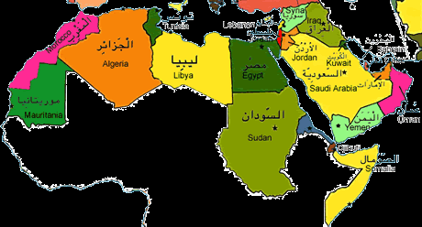
Lesson 9: Inquiring about and identifying Arabic Cities
The map below displays some of the names and locations of some Arab cities.

Slide 24

Review
Review
Make your flash card for this lesson
Questions????

